Slide 1
File Systems
Chapter 6
6.1 Files
6.2 Directories
6.3 File system implementation
6.4 Example file systems

Slide 2
File Systems

Slide 3
Files File Concept
Long-term Information Storage
Must store large amounts of data
Information stored must survive the termination of the process using it
Multiple processes must be able to access the information concurrently
File
Used to store information on disks and other extenal media in units
Process can read them and write new ones if need be
File system – FS (context!!! – NTFS)
Part of operating system dealing with files
Includes two independent parts: set of file and directory structure, organize and provide information about all files in system

Slide 4
Files File Concept
User Abstraction |  | Hardware Resource
Process/Thread |  | CPU
Address Space | ⇐ OS ⇒ | Memory
Files |  | Disk

Slide 5
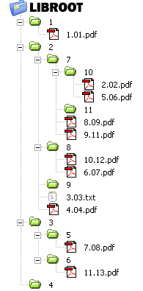
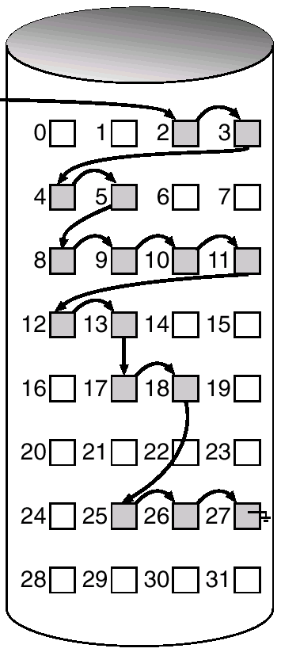
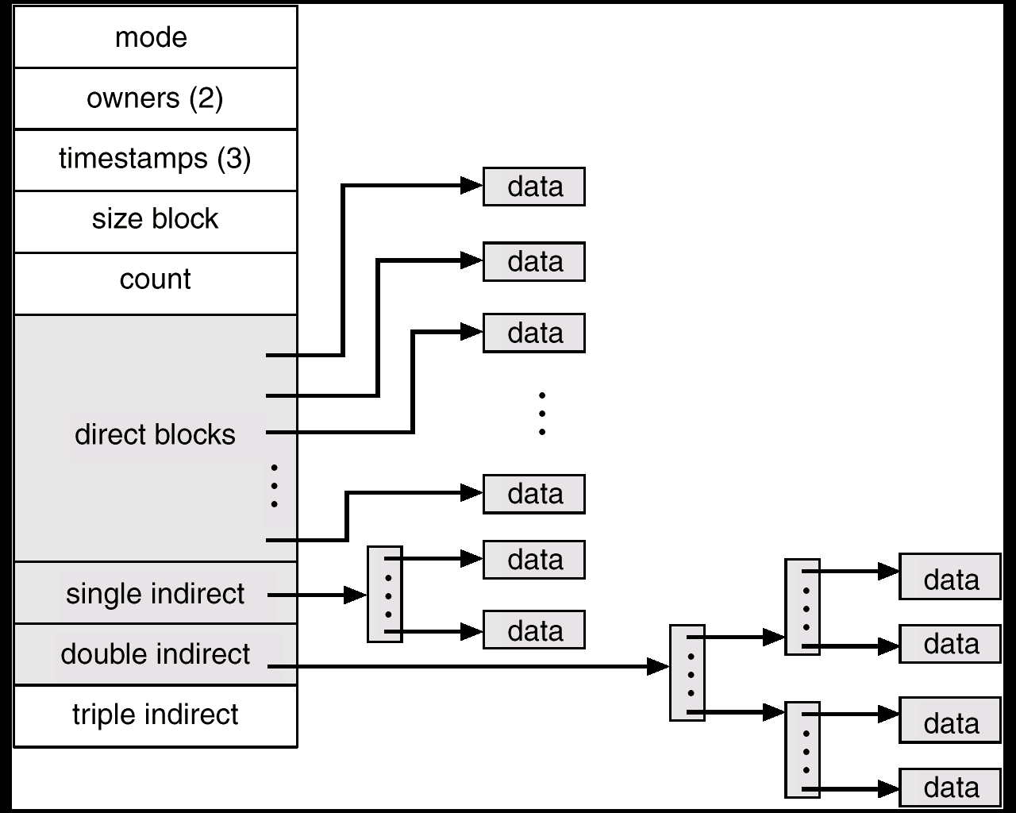
Files File Concept
operating system
physical disk
file system

Slide 6
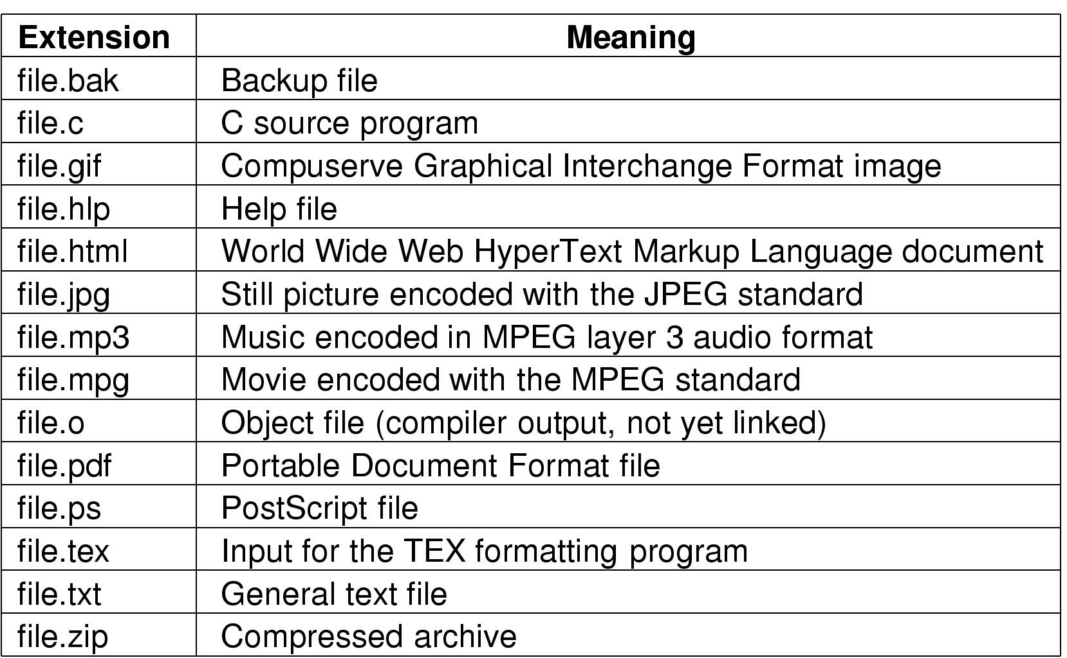
Files File Naming
Typical file extensions.

Slide 7
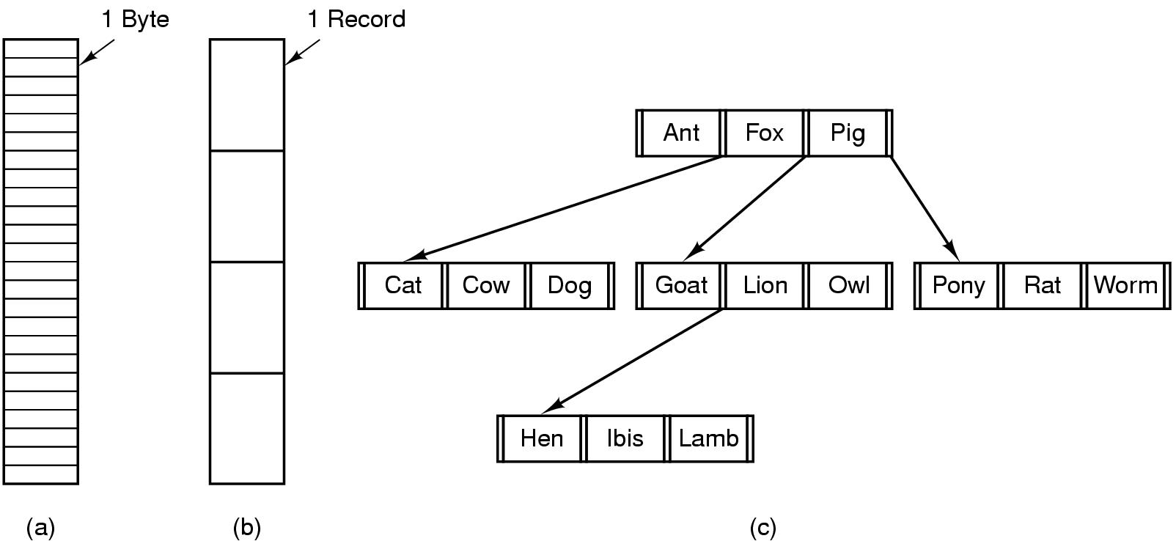
Files File Structure
Three kinds of files
(a) byte sequence
(b) record sequence
(c) tree

Slide 8
Files File Types
Contiguous logical address space
Types:
Data
numeric
character
binary
Program
Source
Object
Executable
Regular, special (character, block)

Slide 9
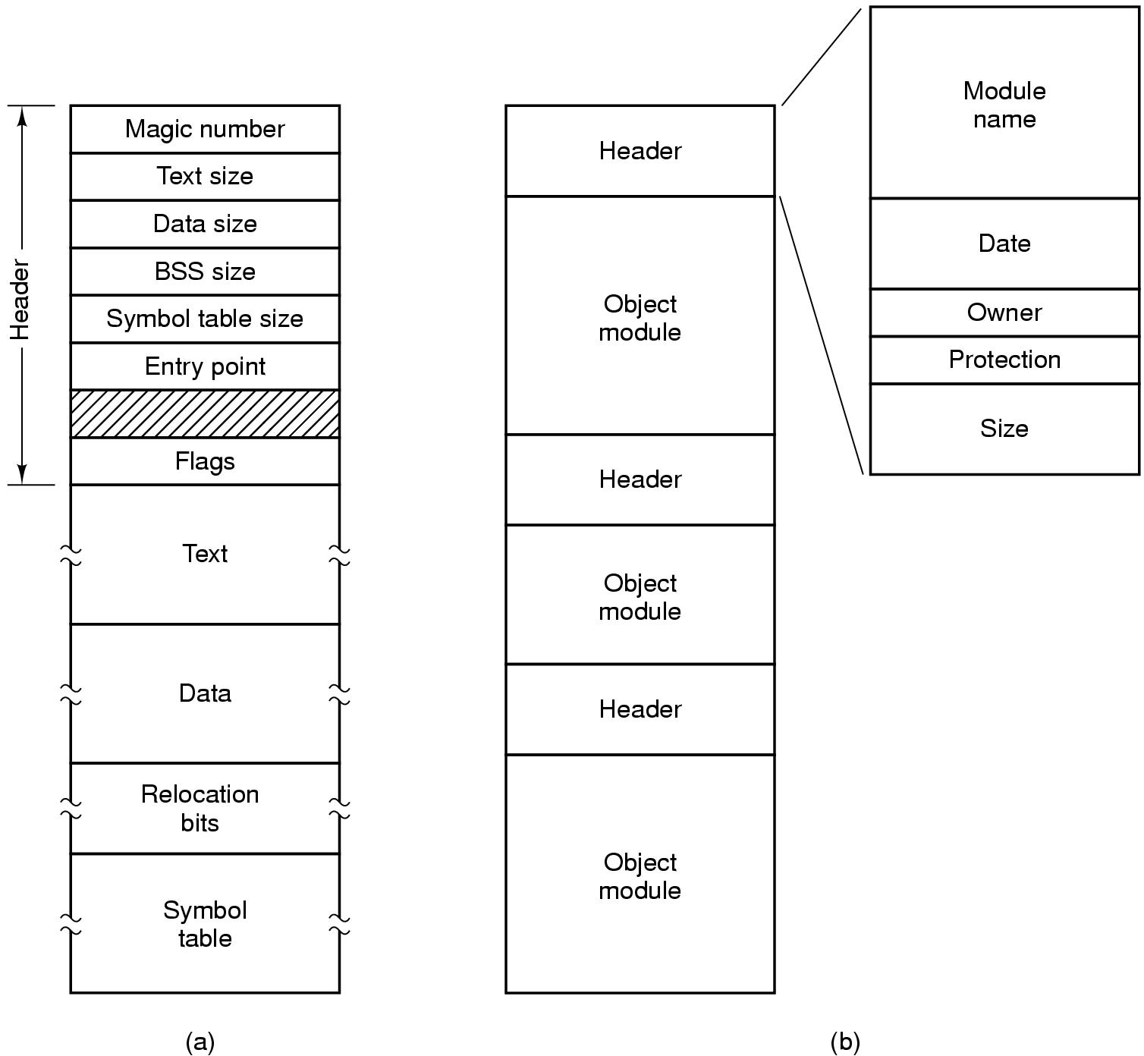
Files File Types
(a) An executable file (b) An archive

Slide 10
Files File Access
Sequential access
read all bytes/records from the beginning
cannot jump around, could rewind or back up
convenient when medium was mag tape
Random access
bytes/records read in any order
essential for database systems
read can be …
move file marker (seek), then read or …
read and then move file marker

Slide 11
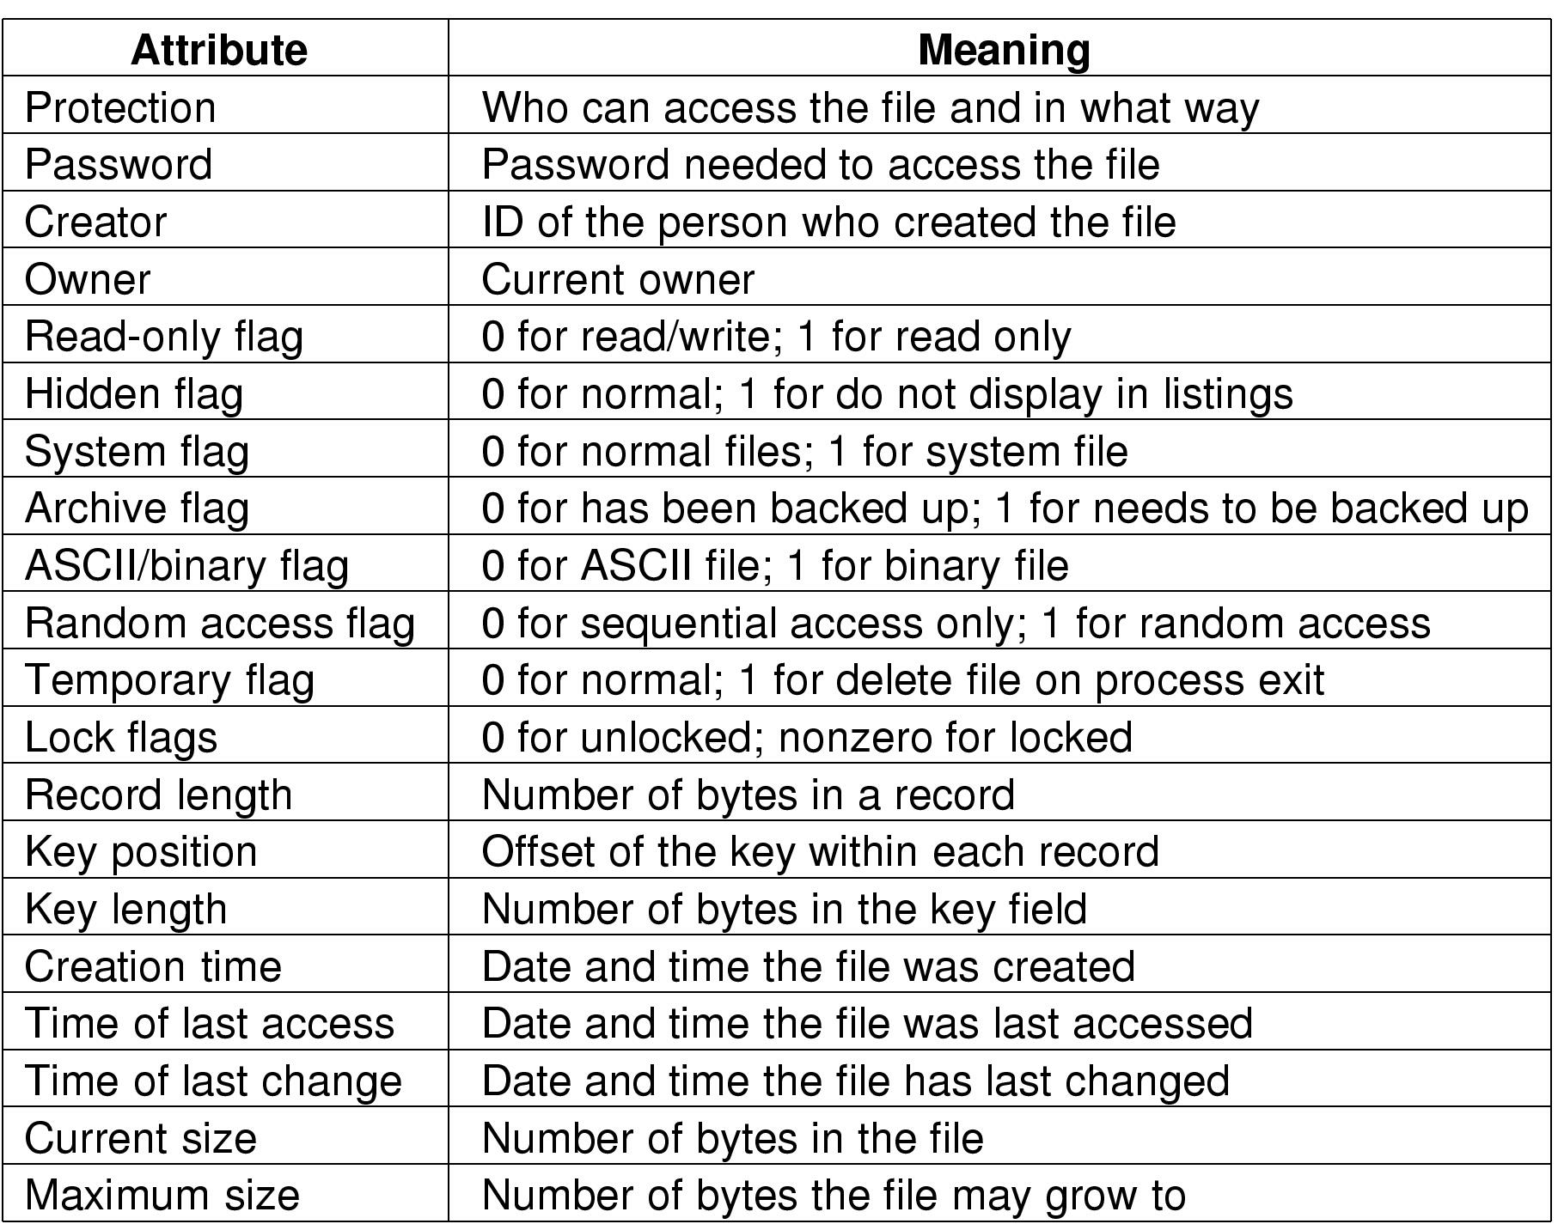
Files File Attributes
Possible file attributes

Slide 12
Files File Operations
Create
Delete
Open
Close
Read
Write
Append
Seek
Get attributes
Set Attributes
Rename

Slide 13
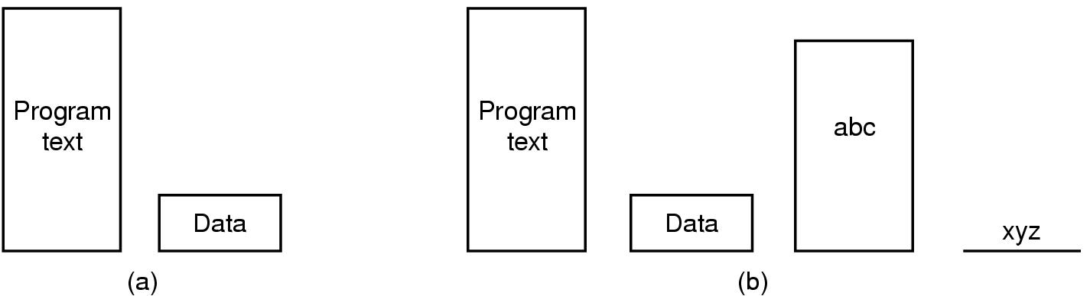
Files Memory-Mapped Files
(a) Segmented process before mapping files into its address space
(b) Process after mapping
existing file abc into one segment
creating new segment for xyz

Slide 14
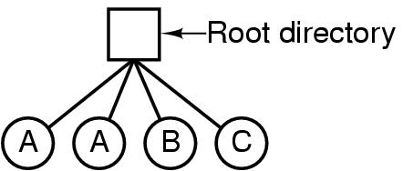
Directories Single-Level Directory Systems
A single level directory system
contains 4 files
owned by 3 different people, A, B, and C

Slide 15
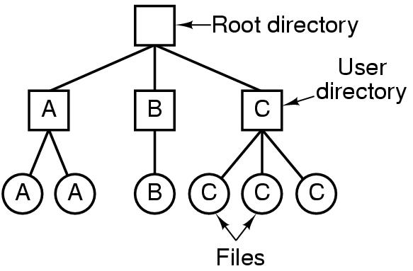
Directories Two-level Directory Systems
Letters indicate owners of the directories and files

Slide 16
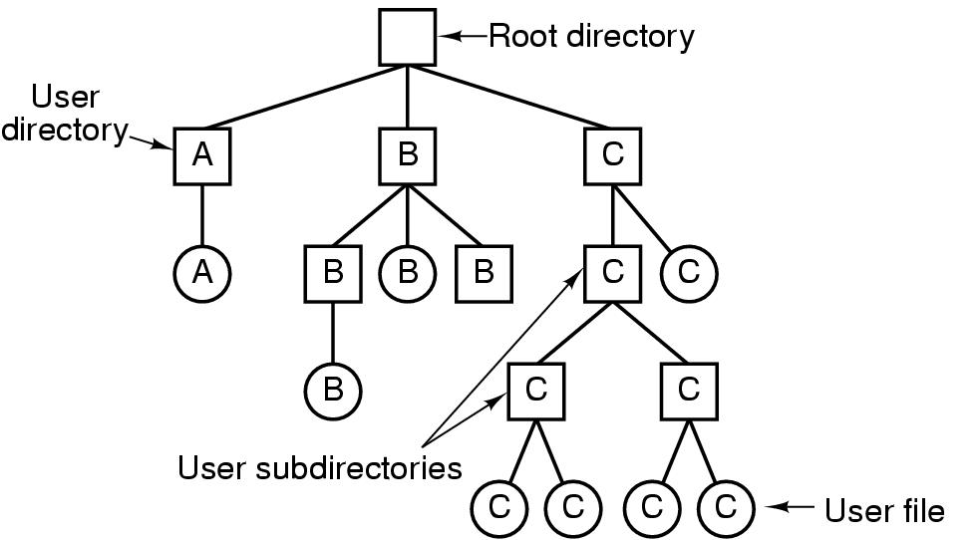
Directories Hierarchical Directory Systems
A hierarchical directory system

Slide 17
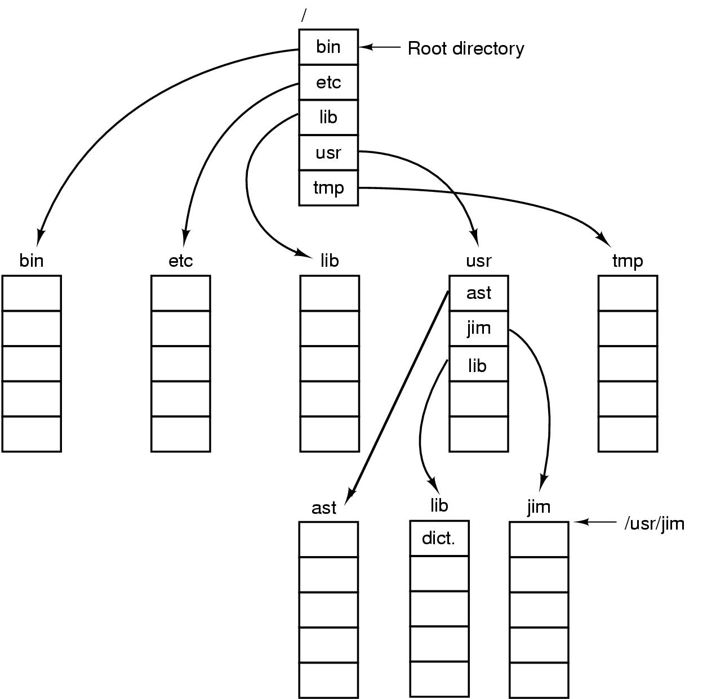
Directories Path Names
A UNIX directory tree

Slide 18
Directories Directory Operations
Create
Delete
Opendir
Closedir
Readdir
Rename
Link
Unlink

Slide 19
File System Implementation

Slide 20
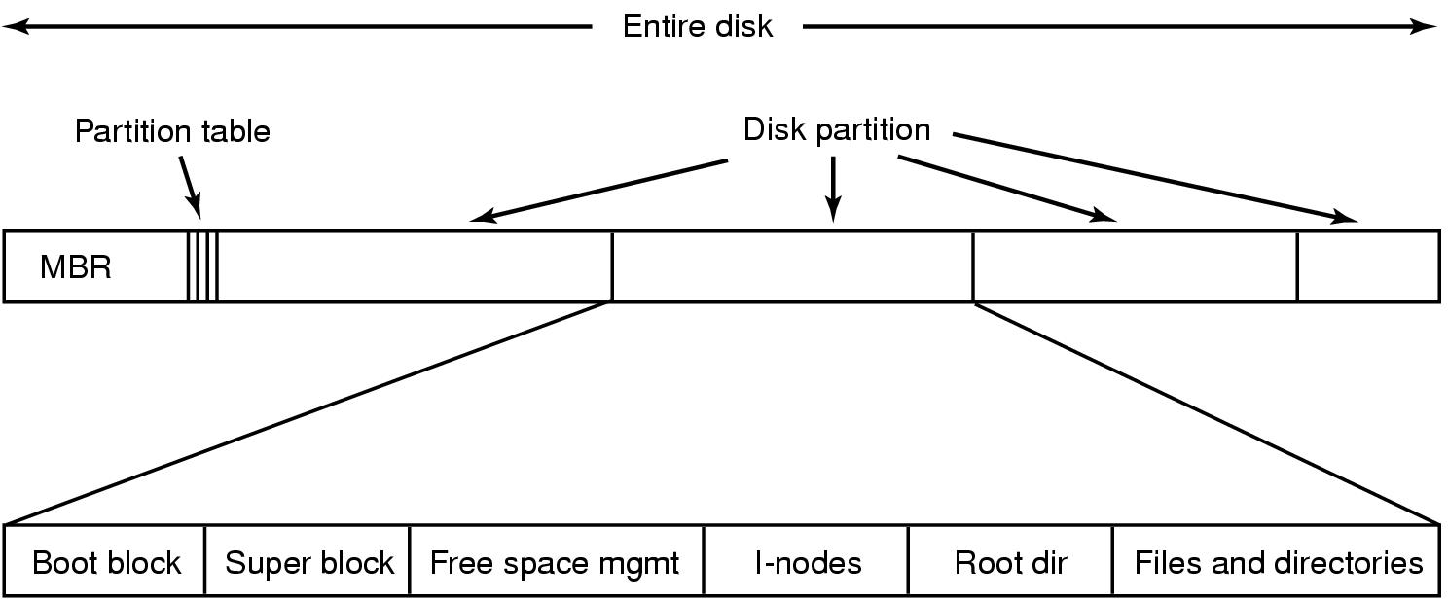
File System Implementation
A possible file system layout
Notes:
A master boot record (MBR) is a special type of boot sector at the very beginning
of partitioned computer mass storage devices like fixed disks or removable drives
intended for use with IBM PC-compatible systems and beyond.

Slide 21
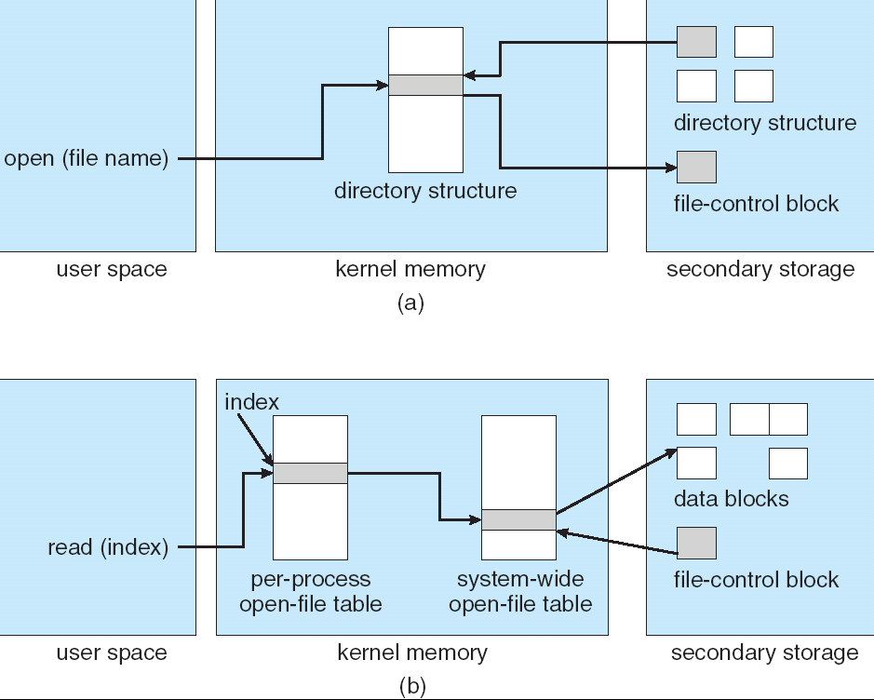
In-Memory File System Structures

Slide 22
File System Implementation Allocation Methods
An allocation method refers to how disk blocks are allocated for files:
Contiguous allocation
Linked allocation
Indexed allocation

Slide 23
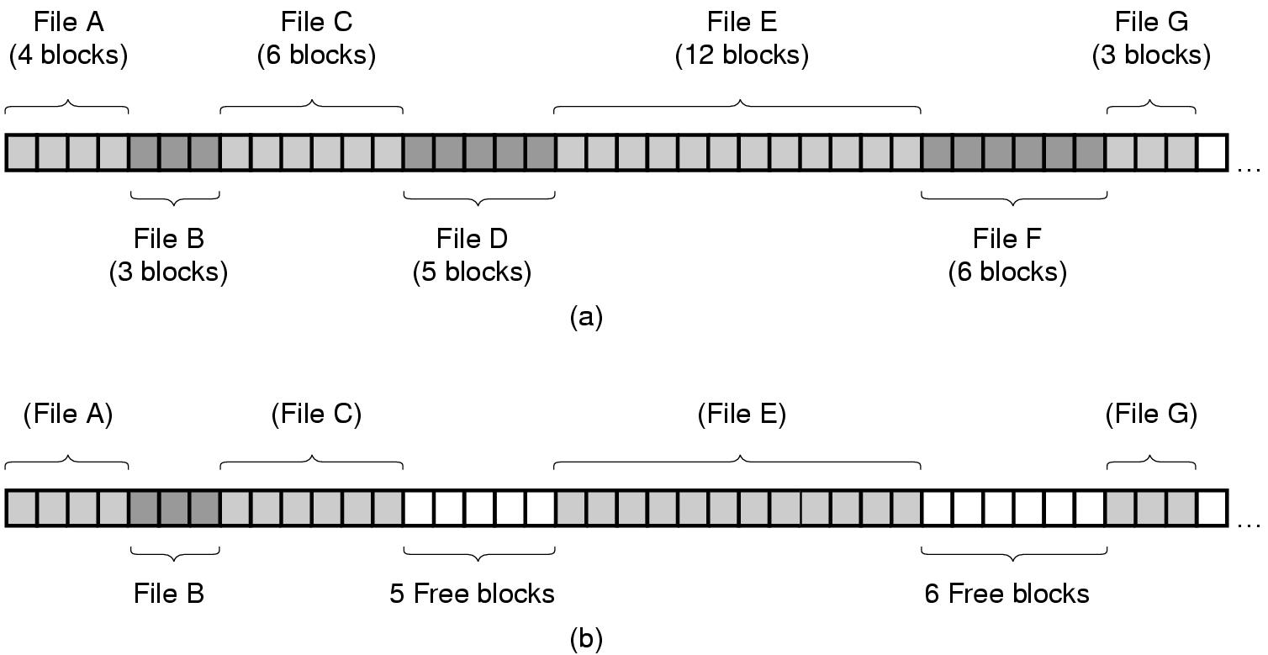
File System Implementation Allocation Methods: Contiguous allocation (1)
(a) Contiguous allocation of disk space for 7 files
(b) State of the disk after files D and F have been removed

Slide 24
File System Implementation Allocation Methods: Contiguous allocation (2)
Each file occupies a set of contiguous blocks on the disk
Simple – only starting location (block #) and length (number of blocks) are required
Random access
Wasteful of space (dynamic storage-allocation problem)
Files cannot grow
Use for CD-ROM because the length of file are known in advance and no deletion

Slide 25
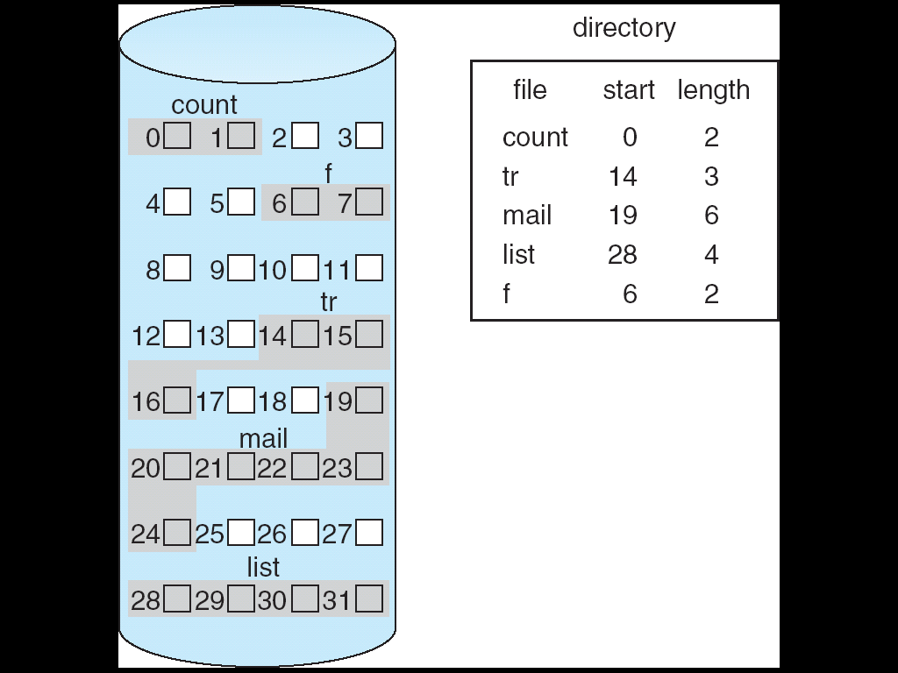
File System Implementation Allocation Methods: Contiguous allocation (3)
Contiguous Allocation of Disk Space

Slide 26
File System Implementation Allocation Methods: Linked allocation (1)
Each file is a linked list of disk blocks: blocks may be scattered anywhere on the disk.
Simple – need only starting address
Free-space management system – no waste of space
No random access
block =
pointer

Slide 27
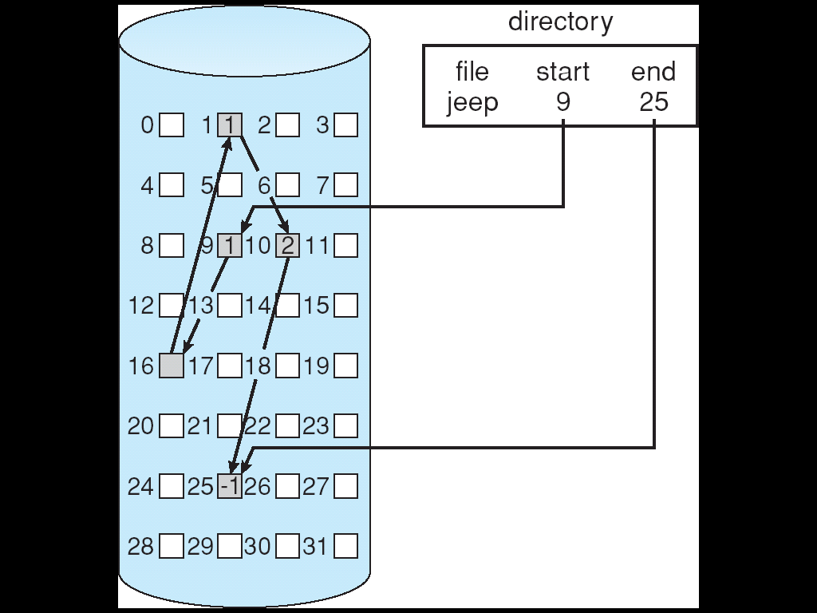
File System Implementation Allocation Methods: Linked allocation (2)

Slide 28
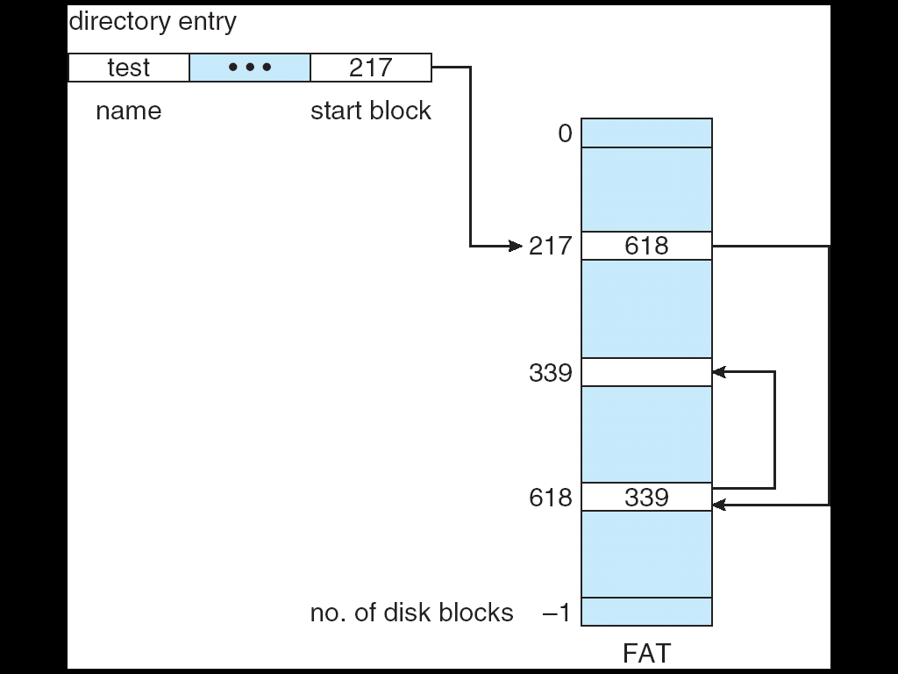
File System Implementation Allocation Methods: Linked allocation (3)
File-Allocation Table

Slide 29
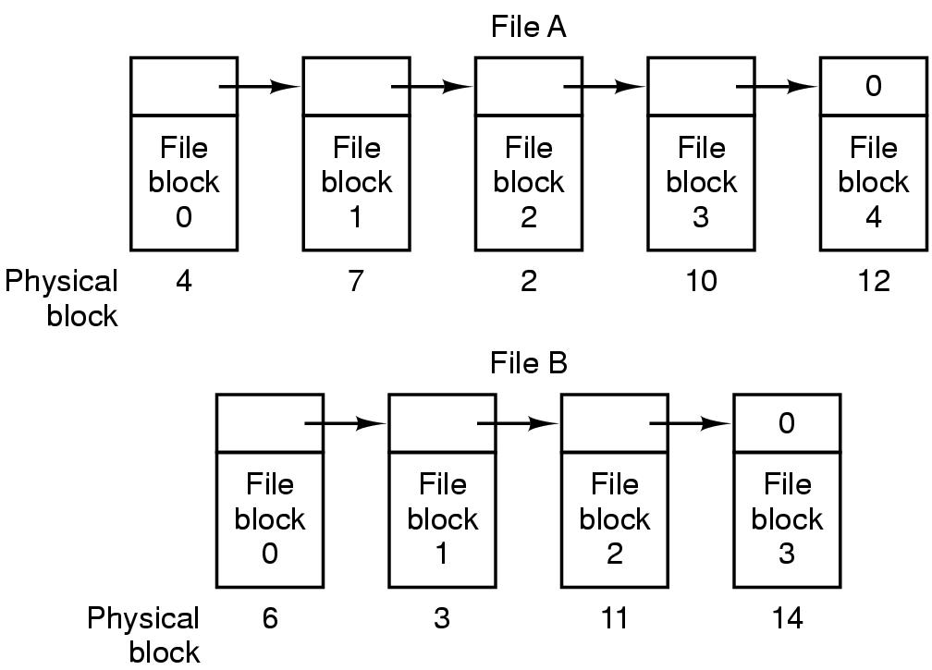
File System Implementation Allocation Methods: Linked allocation (4)
Storing a file as a linked list of disk blocks

Slide 30
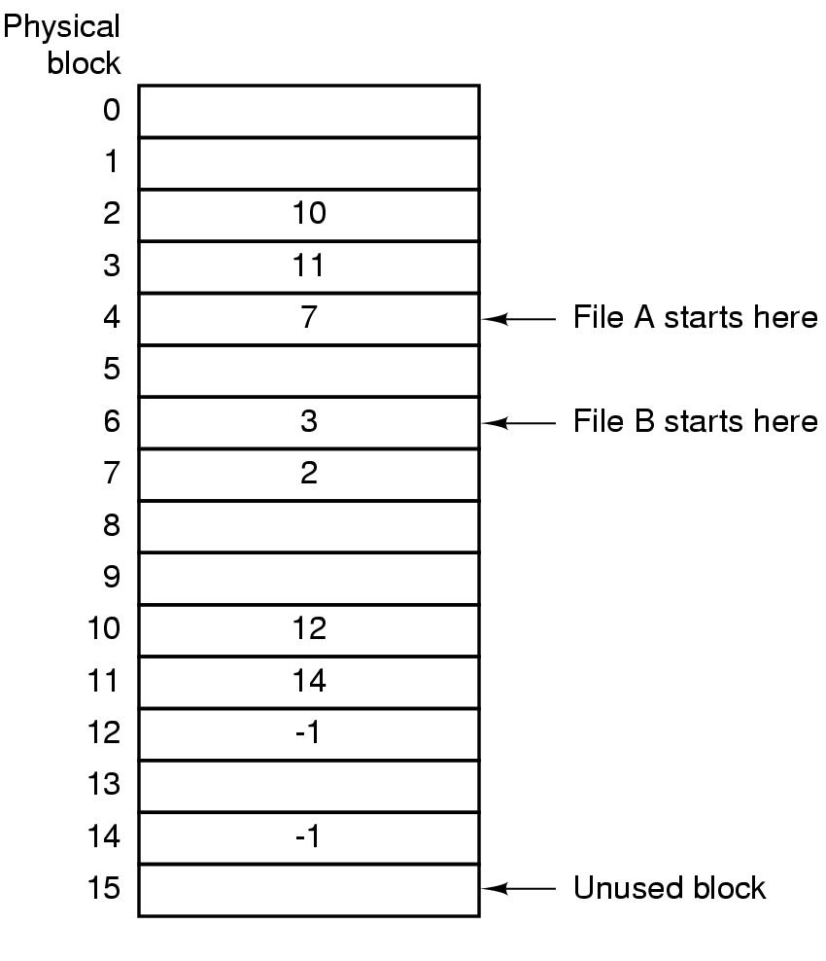
File System Implementation Allocation Methods: Linked allocation (5)
Linked list allocation using a file allocation table in RAM
FAT File Allocation Table

Slide 31
File System Implementation Allocation Methods: Indexed allocation (1)
Brings all pointers together into the index block.
Logical view.
Need index table
Random access
Dynamic access without external fragmentation, but have overhead of index block.
index table

Slide 32
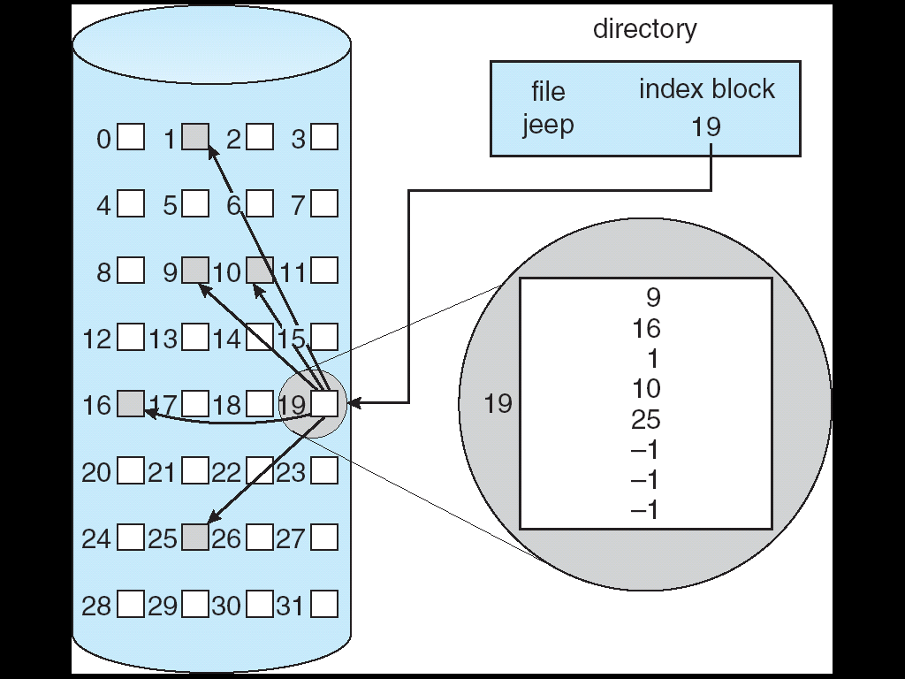
File System Implementation Allocation Methods: Indexed allocation (2)

Slide 33
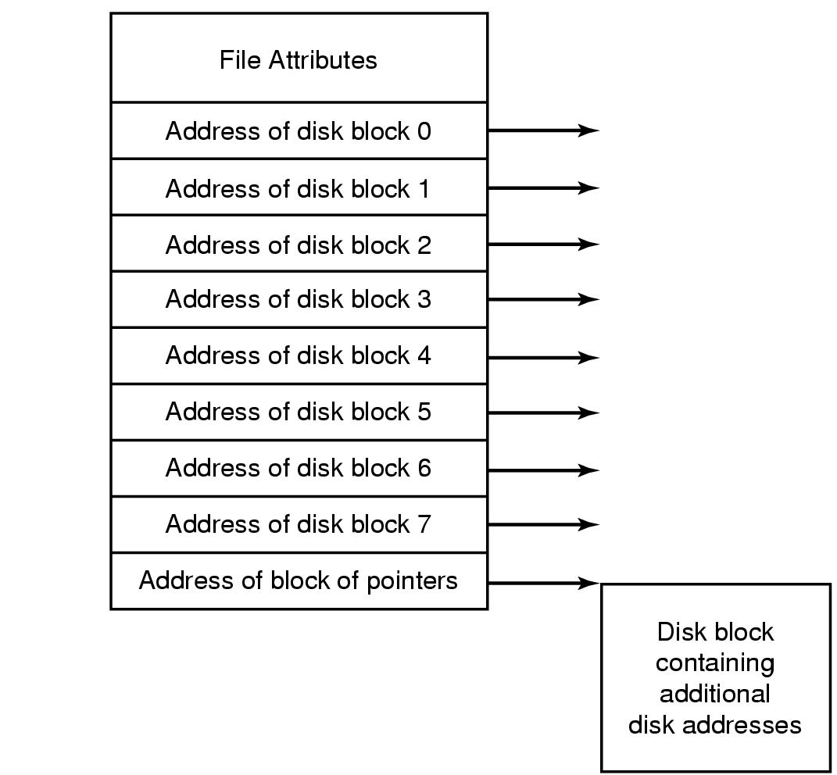
File System Implementation Allocation Methods: Indexed allocation (3)
An example i-node

Slide 34
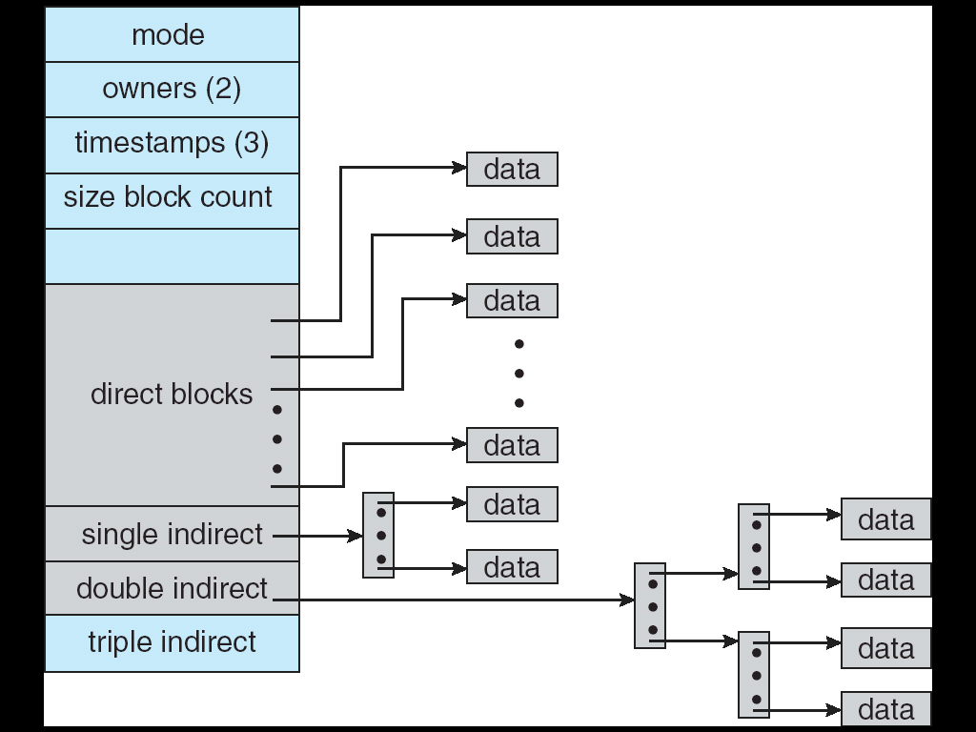
File System Implementation Allocation Methods: Indexed allocation (4)
Combined Scheme: UNIX (4K bytes per block)

Slide 35
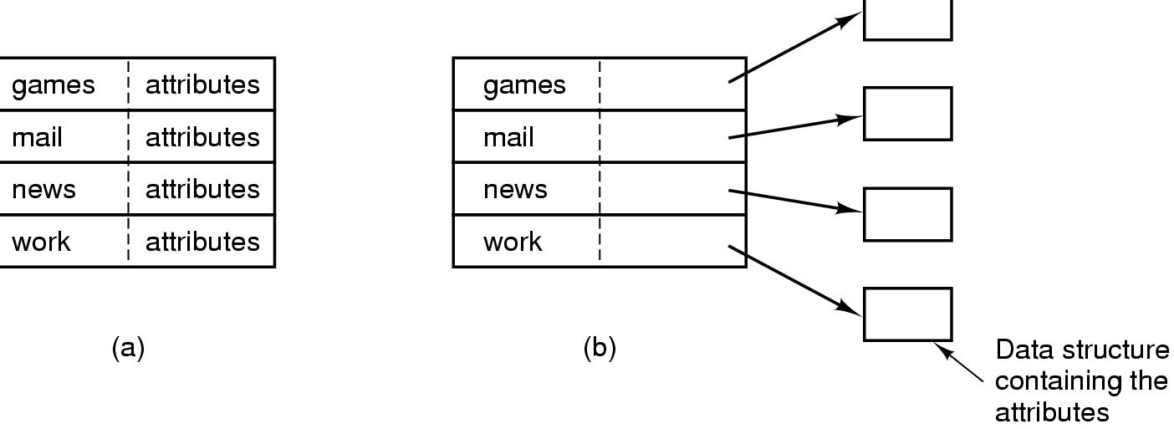
Implementing Directories (1)
(a) A simple directory
fixed size entries
disk addresses and attributes in directory entry
(b) Directory in which each entry just refers to an i-node

Slide 36
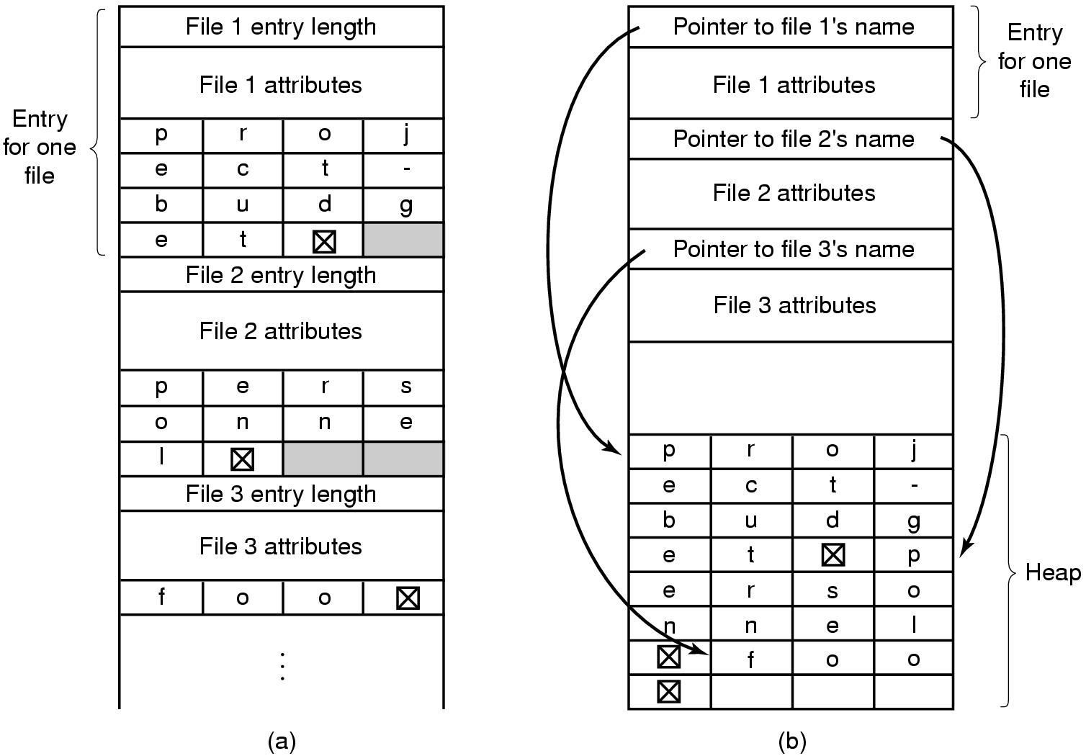
Implementing Directories (2)
Two ways of handling long file names in directory
(a) In-line
(b) In a heap

Slide 37
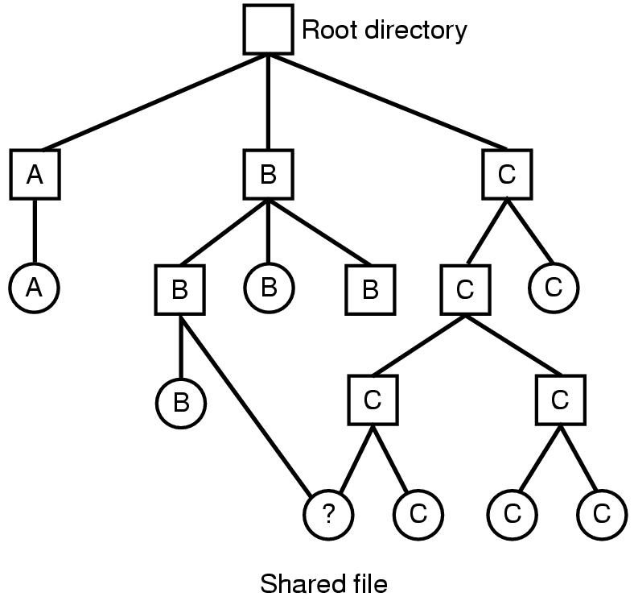
Shared Files (1)
File system containing a shared file

Slide 38
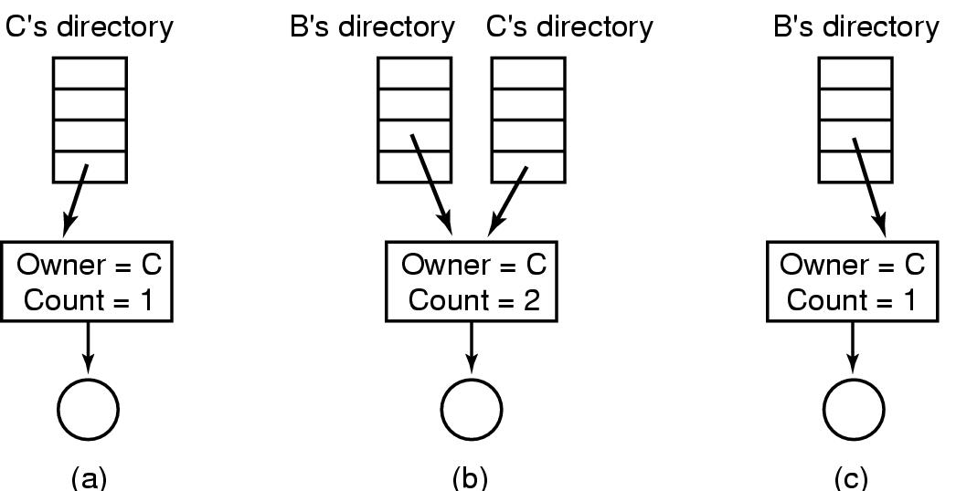
Shared Files (2)
(a) Situation prior to linking
(b) After the link is created
(c)After the original owner removes the file

Slide 39
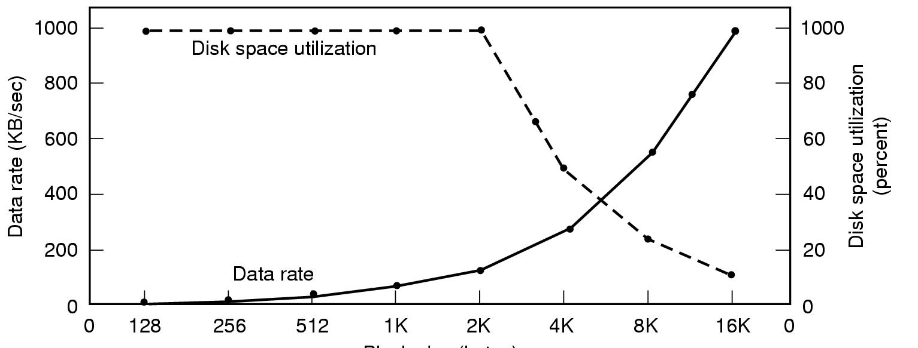
Disk Space Management (1)
Block size
Dark line (left hand scale) gives data rate of a disk
Dotted line (right hand scale) gives disk space efficiency
All files 2KB

Slide 40
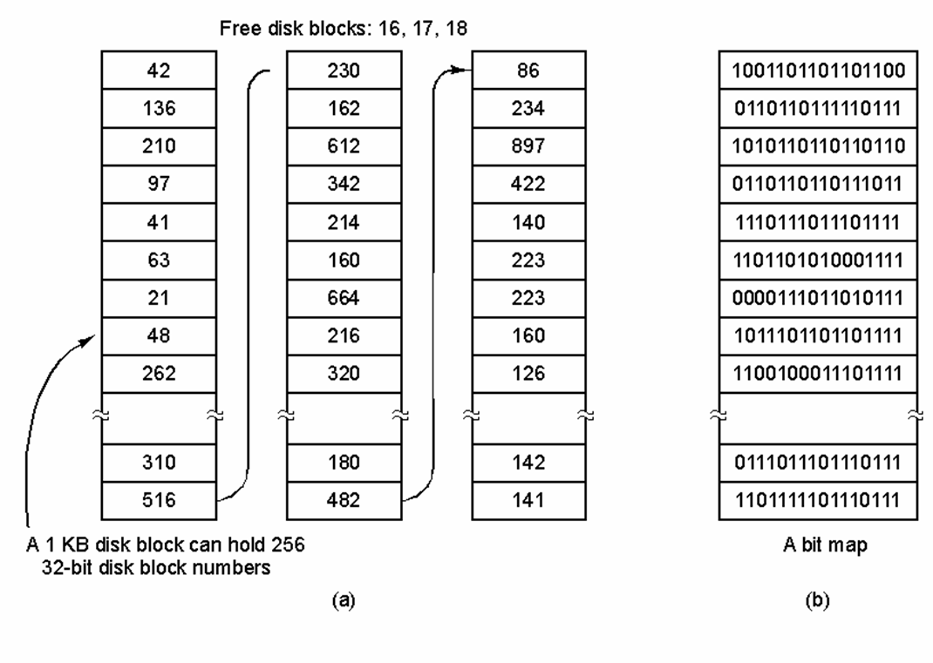
Disk Space Management (2)
(a) Storing the free list on a linked list
(b) A bit map

Slide 41
Example File Systems

Slide 42
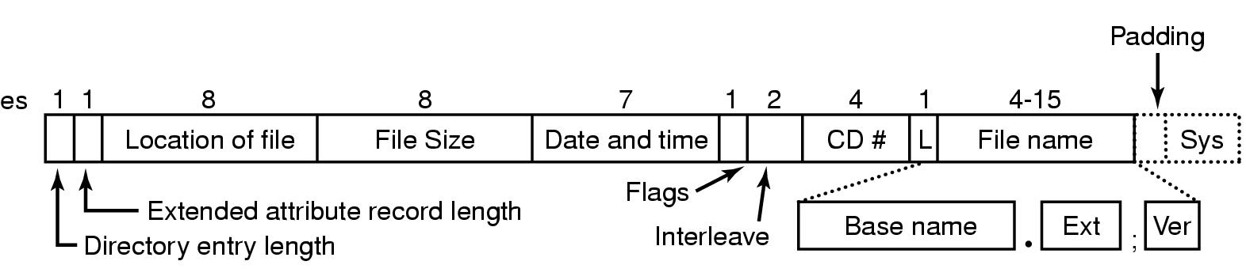
Example File Systems CD-ROM File Systems
The ISO 9660 directory entry

Slide 43
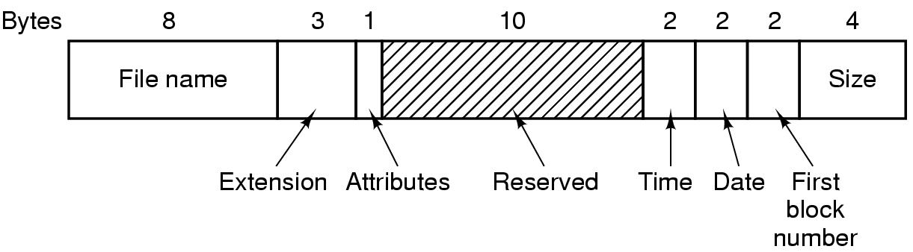
The MS-DOS File System (1)
The MS-DOS directory entry

Slide 44
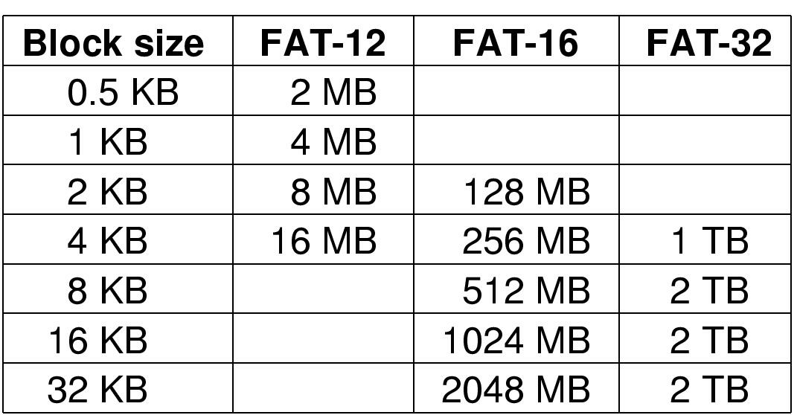
The MS-DOS File System (2)
Maximum partition for different block sizes
The empty boxes represent forbidden combinations

Slide 45
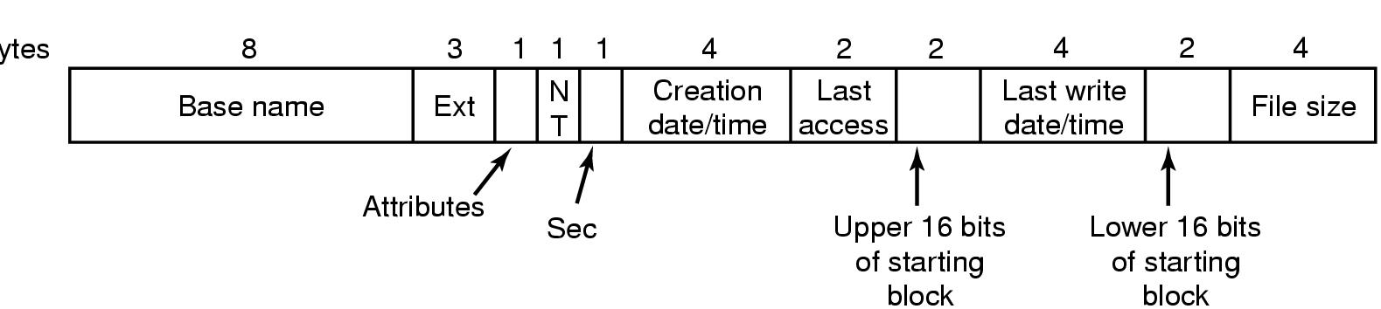
The Windows 98 File System (1)
Bytes
The extended MOS-DOS directory entry used in Windows 98

Slide 46
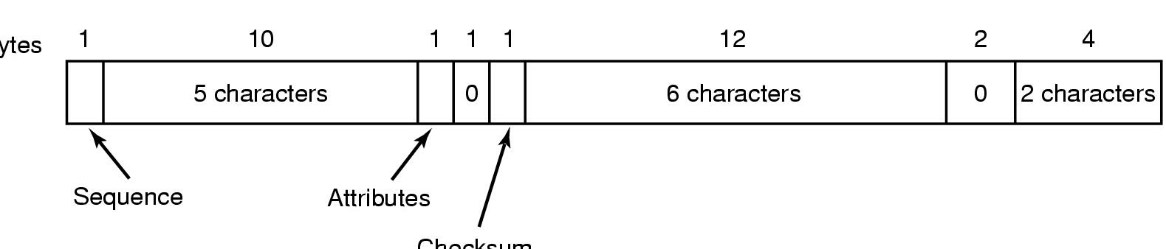
The Windows 98 File System (2)
Bytes
Checksum
An entry for (part of) a long file name in Windows 98

Slide 47
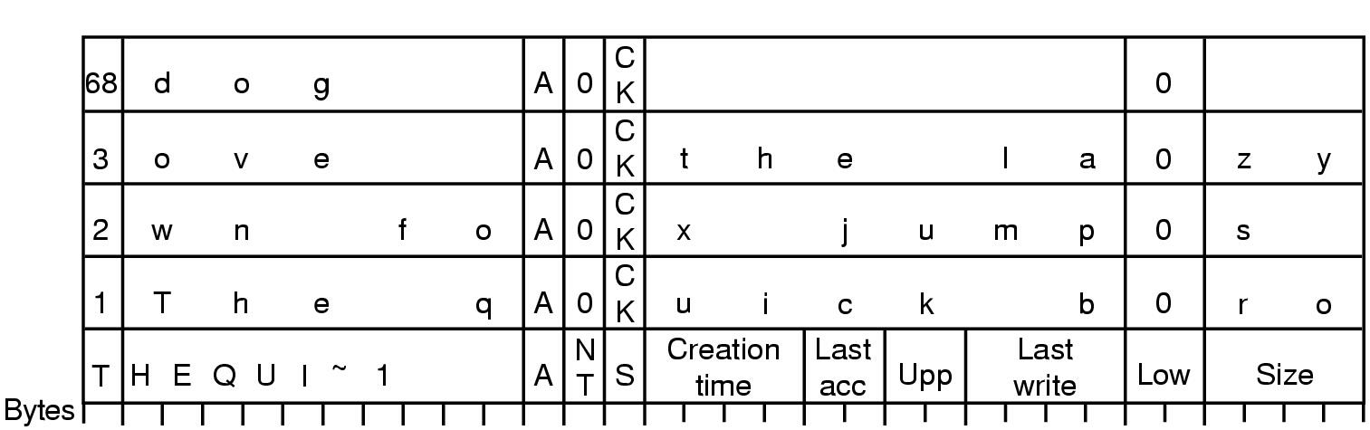
The Windows 98 File System (3)
An example of how a long name is stored in Windows 98

Slide 48
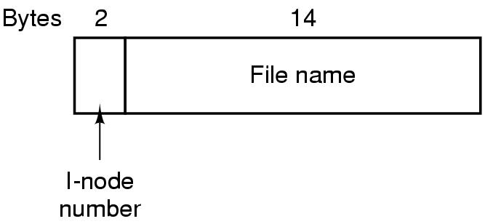
The UNIX V7 File System (1)
A UNIX V7 directory entry

Slide 49
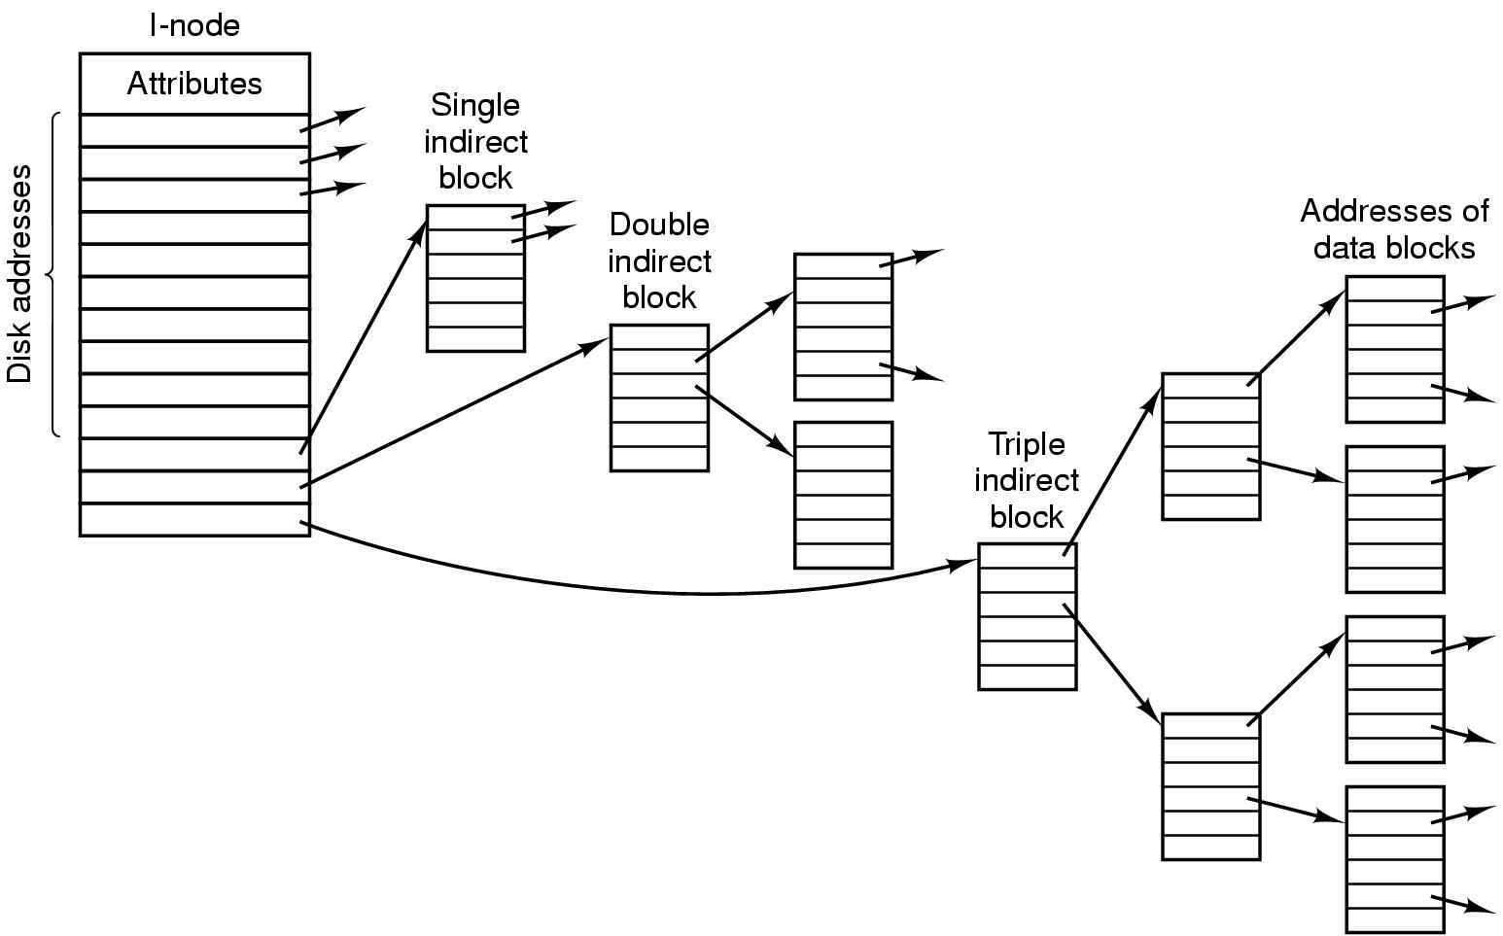
The UNIX V7 File System (2)
A UNIX i-node

Slide 50
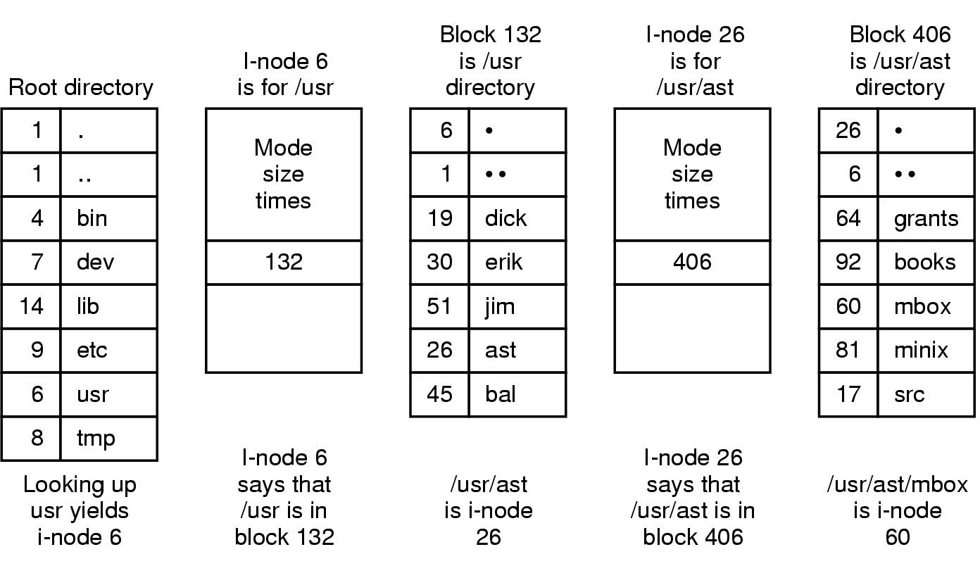
The UNIX V7 File System (3)
The steps in looking up /usr/ast/mbox

